Slide 1
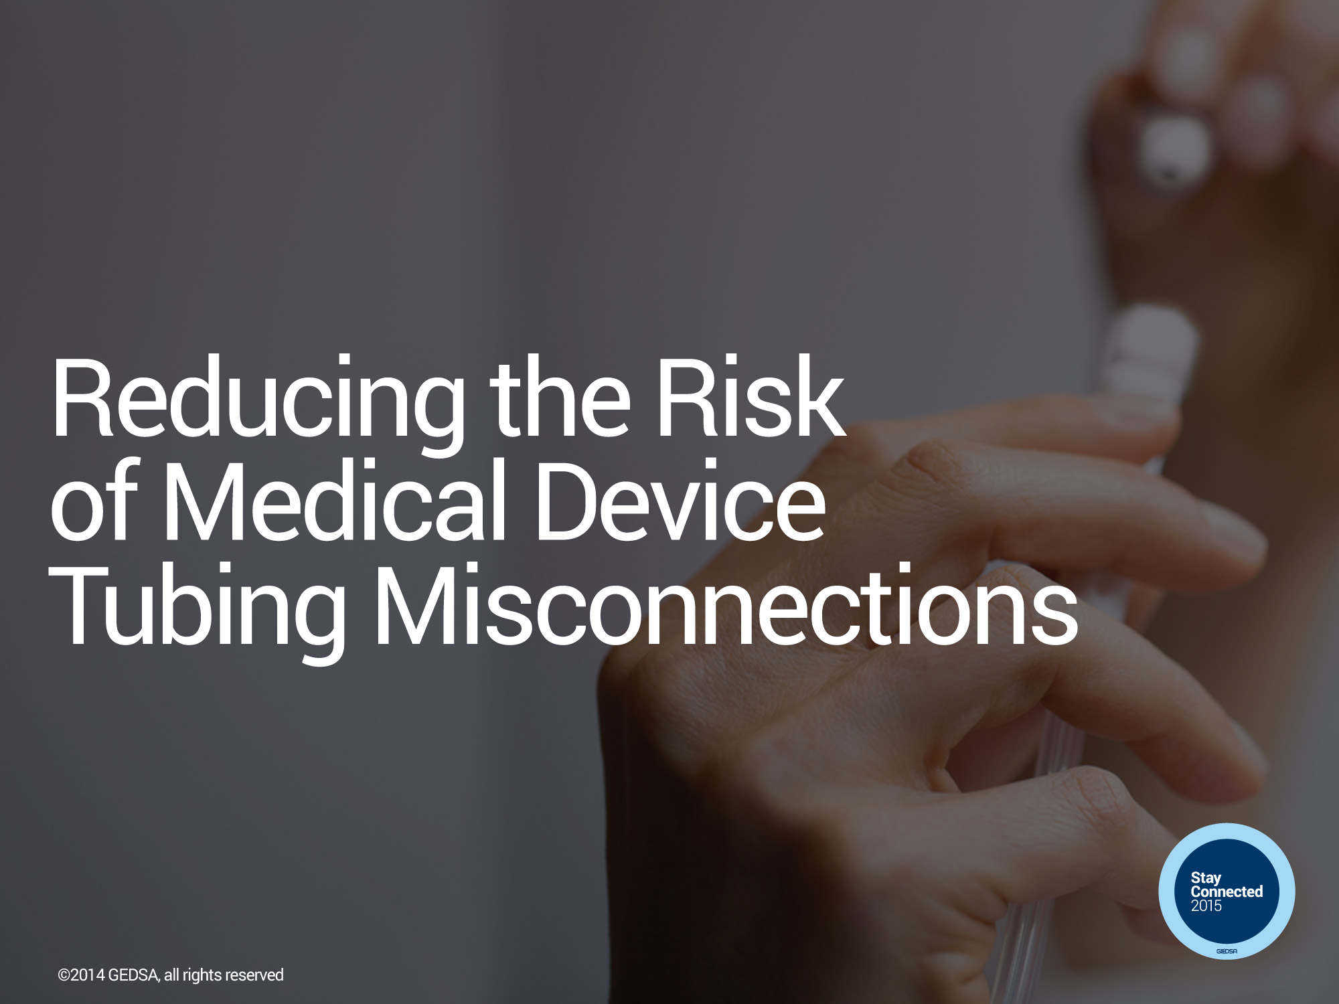


Stayconnected.org

Slide 2
GEDSA MISSION
Promote initiatives surrounding safe and optimal delivery of enteral feeding and connectivity
Stayconnected.org

Slide 3

GEDSA Members
Abbott
A. Hopf
Alcor Scientific
Amsino
Bard
Baxter
B Braun
Boston Scientific
Cair Lgl
Cedic/Entek
Codan
Cook Medical
Corpak
Dale Medical
Degania
Enteral UK
Fresenius Kabi
Halyard
Intervene
Medela
Medicina
Medline
Medtronic
Moog
NeoMed
Nestle
Nutricia
Qosina
Smiths Medical
UComfor
Vesco Medical
Vygon
VR Medical/Kentec
Xeridiem
Stayconnected.org

Slide 4















Supporting Organizations
Stayconnected.org
Notes:
Building relationships across the industry has been an instrumental part of the process—leveraging their experts, communication vehicles, and built-in audiences

Slide 5
Tubing Misconnections Adverse Events
IV tubing misconnected to a nasal cannula used to deliver oxygen — the patient survived after being treated for congestive heart failure
Epidural infusion set connected to a peripheral IV, delivering epidural medication to bloodstream, resulting in patient death
Feeding tube connected to an in-line ventilator suction catheter, delivering feeding contents into the patient’s lungs, resulting in death
Heparin lock (peripheral IV route) connected to an automatic blood pressure cuff, delivering air to the bloodstream, causing death
Feeding tube was coupled with a peripheral line of a pregnant woman, resulting in enteral nutrition delivered directly into the bloodstream; neither the 35-week-old fetus nor the woman survived
Stayconnected.org

Slide 6
Low Lighting
Multiple Devices
Multiple Lines
Compatible Connectors
Time Pressure
Compatible Connectors
Dis-connections
Lack of Tactile Feedback
Unintended Use of Tubes
Moving Patient Setting
Stayconnected.org

Slide 7
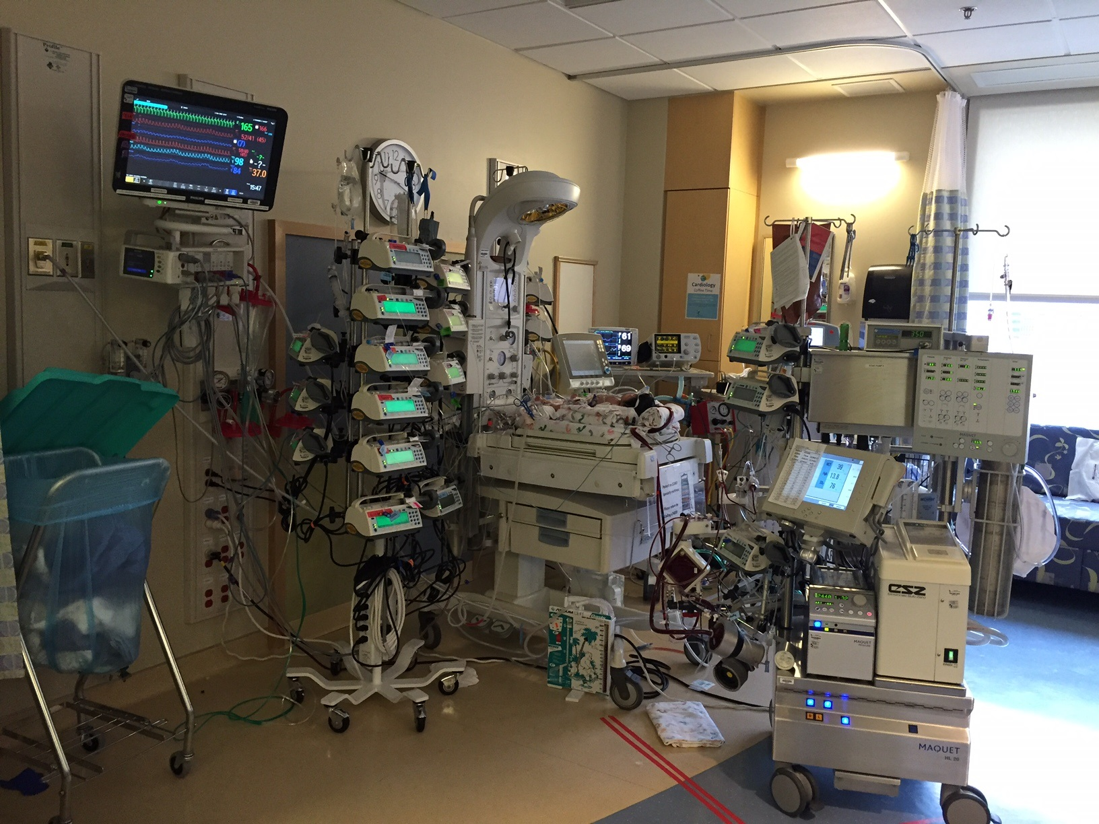
Stayconnected.org

Slide 8
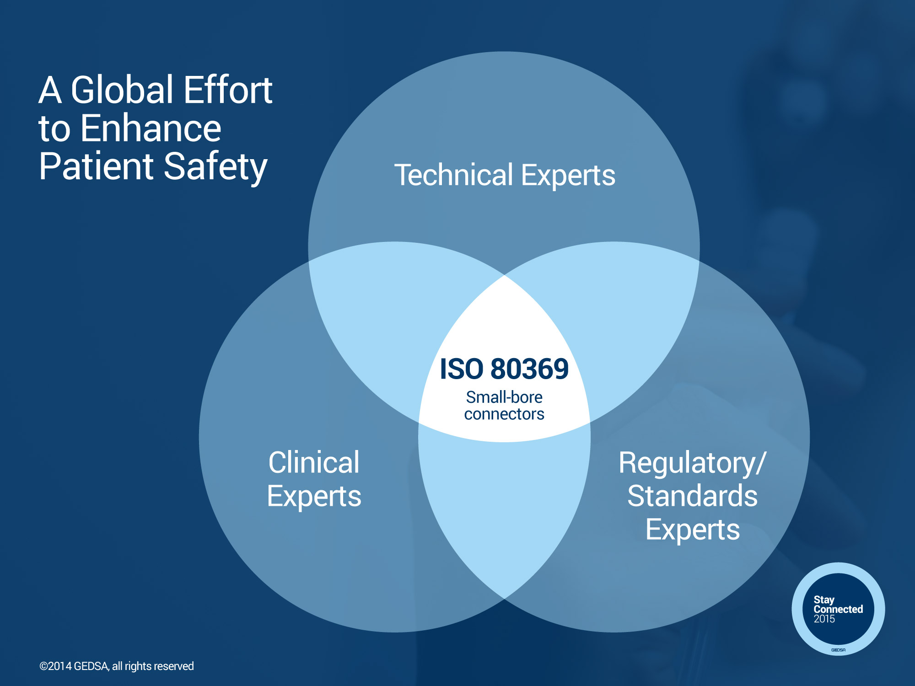
Stayconnected.org
Notes:
An international working group of clinicians, manufacturers, and regulators developed ISO 80369-1, a standard that establishes requirements for small-bore connectors.
This means establishing unique design standards for each clinical application so tubing from one application is incompatible with another.

Slide 9
ISO Design standards developed for system-specific applications
80369 Series
-1 General requirements
Respiratory | Enteral | Urological | Limb Cuff | Neuraxial | Intravascular
-2 | -3 | -4 | -5 | -6 | -7
Requirements:
Not connectable with others in series
Rigid or semi-rigid
Passes Misconnection, Risk Analysis, Usability/Human Factors Testing
Not connectable with Luer or needleless connector ports
Stayconnected.org

Slide 10
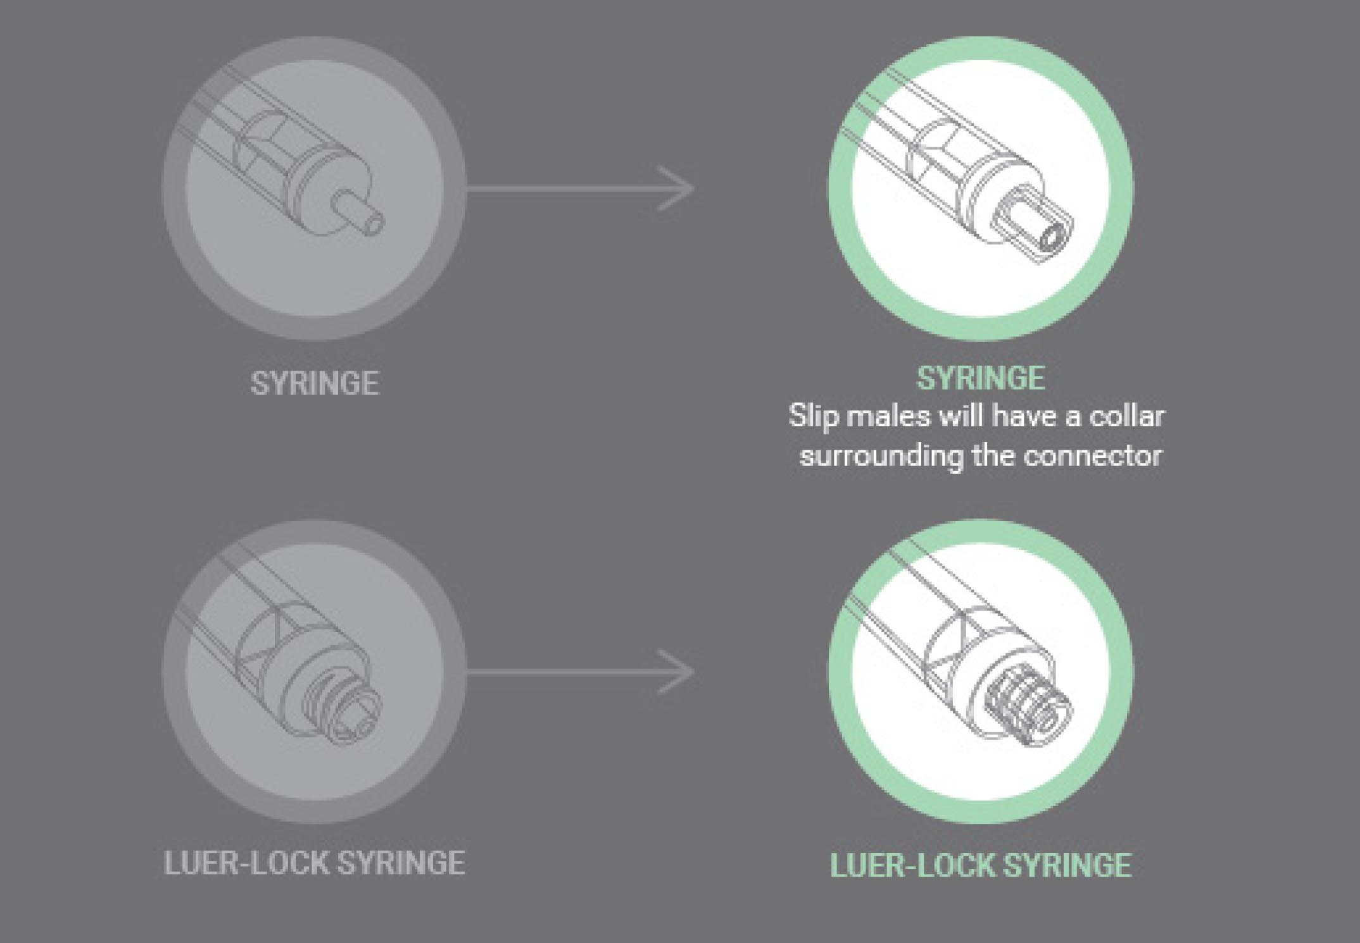
CURRENT LUER NEW NRFit

Slide 11
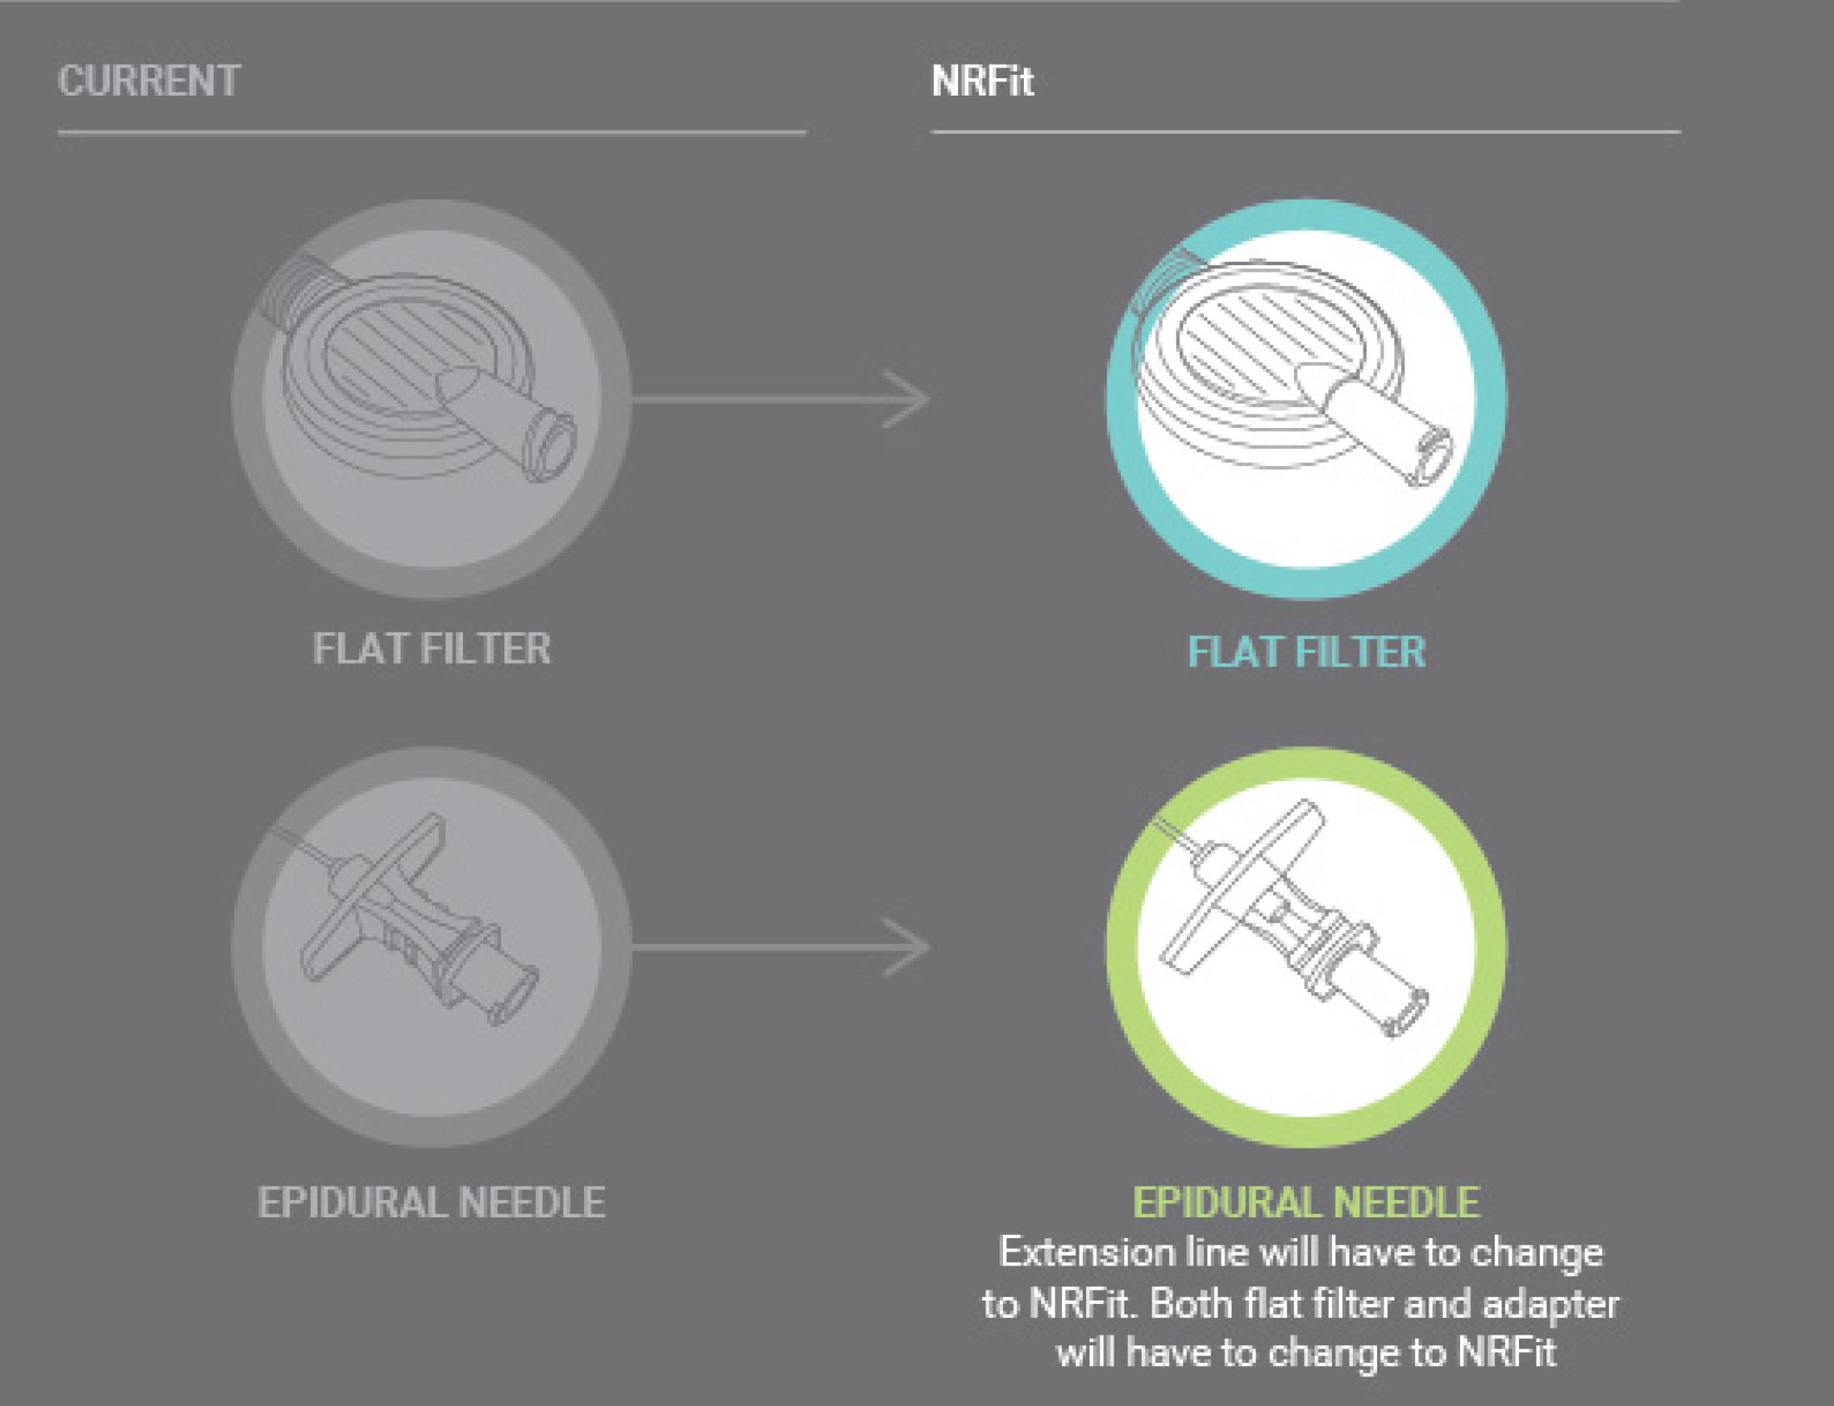
Introducing NRFit the ISO 80369-6 Standard Connector
CURRENT LUER NEW NRFit

Slide 12
Examples of Devices impacted by ISO 80369-6 (NRFit):
Epidural/Spinal Applications: Spinal Needle, Epidural Needle, Filter Needle, Drawing Up Needle, Drawing Up Straws, 0.2 Micron Disc Filter, 0.2 Micron Needle Filter, Infusion Pump Accessories, Patient Access Catheter Connector, Syringe to Syringe Transfer Device, Individually Packaged Slip Syringes, Slip Syringes, LOR Syringes, Epidural Stopcocks, Epidural Filter, Epidural Administration Sets, Spinal Manometer, Three way tap, Blood Patch Kit, Adapter for epidural blood patch
Major Regional Anesthesia: Nerve block needles, Individually packaged Lock Syringes, Individually packaged draw up needles, Syringe Caps
Continuous Wound Infusion: Silastic LA Infusion Device, Catheter for Wound Infusion, Individually Packaged Lock Syringes, Individually Packaged Draw Up Needles
Equipment for Specialist Training: Omnaya Reservoir Needles, Huber Needles, Spinal Catheters, External Ventricular Drains, External Ventricular Accessories, RF Needles, RF Accessories, CSF Pressure Transducer Sets
Note: It is important to speak with your manufacturer to understand their stance on a spinal introducer needle connector change.
Stayconnected.org

Slide 13
US Neuraxial Products
Estimated Launch Timelines
AB444 Epidural Deadline
Neuraxial Pump Set Introduction
Neuraxial Kit Introduction
Q1 ’16 | Q2 ‘16 | Q3 ‘16 | Q4 ‘16 | Jan ’17 | Feb ‘17 | Mar ’17 | Apr ’17 | May ’17 | Jun ’17 | Jul ’17 | Aug ’17 | Sep ’17 | Oct ‘17 | Nov ‘17 | Dec ‘17
Final time lines are dependent on sufficient inventory and regulatory clearances. Consult individual manufacturers for specifics.
FDIS
Approved
PUBLISHED
ISO Standard
FDA Recognized Standard
Stayconnected.org

Slide 14
AB444 – CA Misconnection Law
AB444 signed into law August 8, 2015
Patient Safety Provisions for California Healthcare Facilities
  January 2016 - IV equipment with cross compatibility are prohibited from use except in emergency situations
  July 2016 – Enteral equipment with cross compatibility are prohibited from use except in emergency situations
  January 2017 – Epidural equipment with cross compatibility are prohibited from use except in emergency situations
No Reported Enforcement
Stayconnected.org

Slide 15
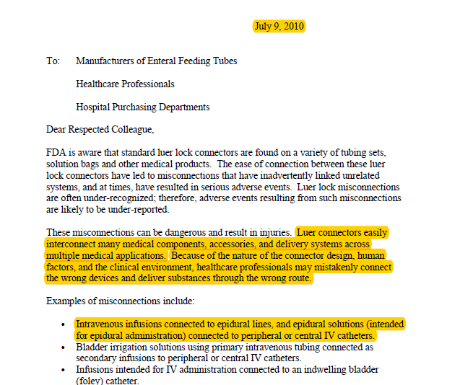
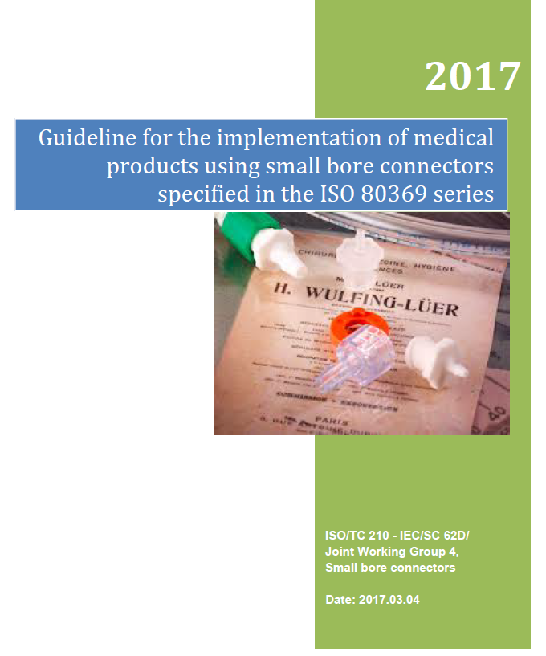
FDA Actions
2010 Warning letter
Recognition of ISO standard 80369
Continuing cooperation with ISO committee to assist stakeholder conversion efforts
Stayconnected.org

Slide 16
Process & Timeline
Aware
Participation in Informational Webinars/Calls
Prepare
Education
Risk Assessments/FMEA, Brainstorming, Scope of product impacts
Hands on with products
Adopt
Transition
Meeting with community partners, distributors,
Communication
Stayconnected.org

Slide 17
Internal Team Awareness
Build your cross-functional team.
Leader
Nursing
Pharmacy
Provider
Surgery
Supply Chain
Patient Safety Leader
Discharge Planning
Risk Management
Anesthesia
Oncology
Stayconnected.org

Slide 18
Internal Meetings
Date | Task | Owner | Status
Bi-Weekly Meetings | Set meeting objectives | Who is leading the meeting? | Action Items & Items completed
Knowledge of NRFit
Workflow changes
Ability to educate Clinicians and caregivers of changes
Need to order medications with correct delivery route
General awareness
Care Coordination
Risk of supplies not being available for patient needs, delays in receiving care, feeds, medications
Coordination of home care needs and supplies
Stayconnected.org

Slide 19
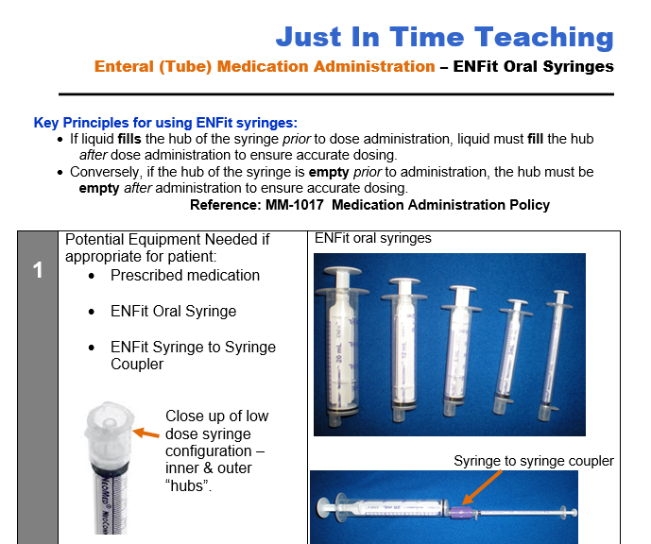
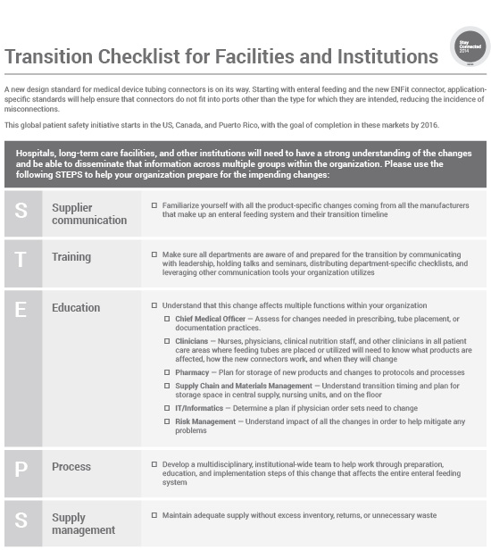
Master Tool Kit - Prepare
List of impacted products
Checklists for every part of the hospital can use to prepare
Crosswalk of their changing products
Educational materials that caregivers, patients, and home health companies can utilize
Continue building the tool kits you find helpful
Current Product Description | MFO Item # | Current Lawson # | Current UOM | UOM Factor | New Product Description | New Mfg # | New Lawson #
Tube Feeding Gastrostomy 14Fr LF | 0020212 | 232495 | Ea | 1 | Tube Feeding ENFit 14Fr LP | 0080818 | 232459
Stayconnected.org

Slide 20
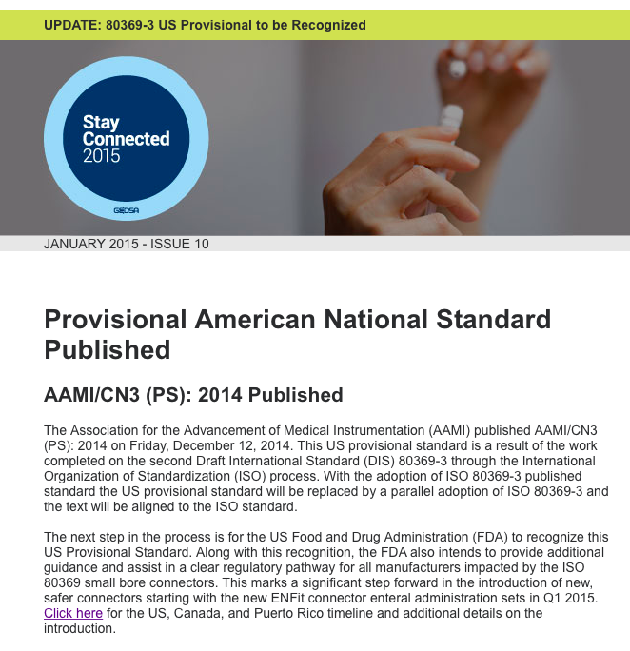
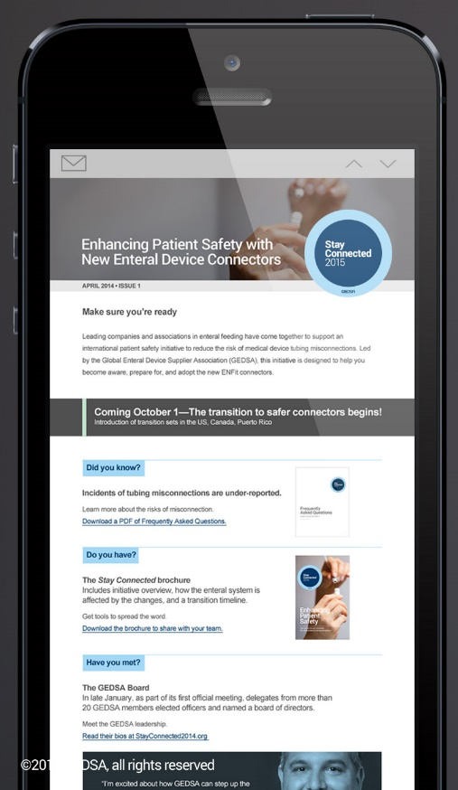

Brochures, Presentations, FAQs & Checklists
www.stayconnected.org

